Slide 1
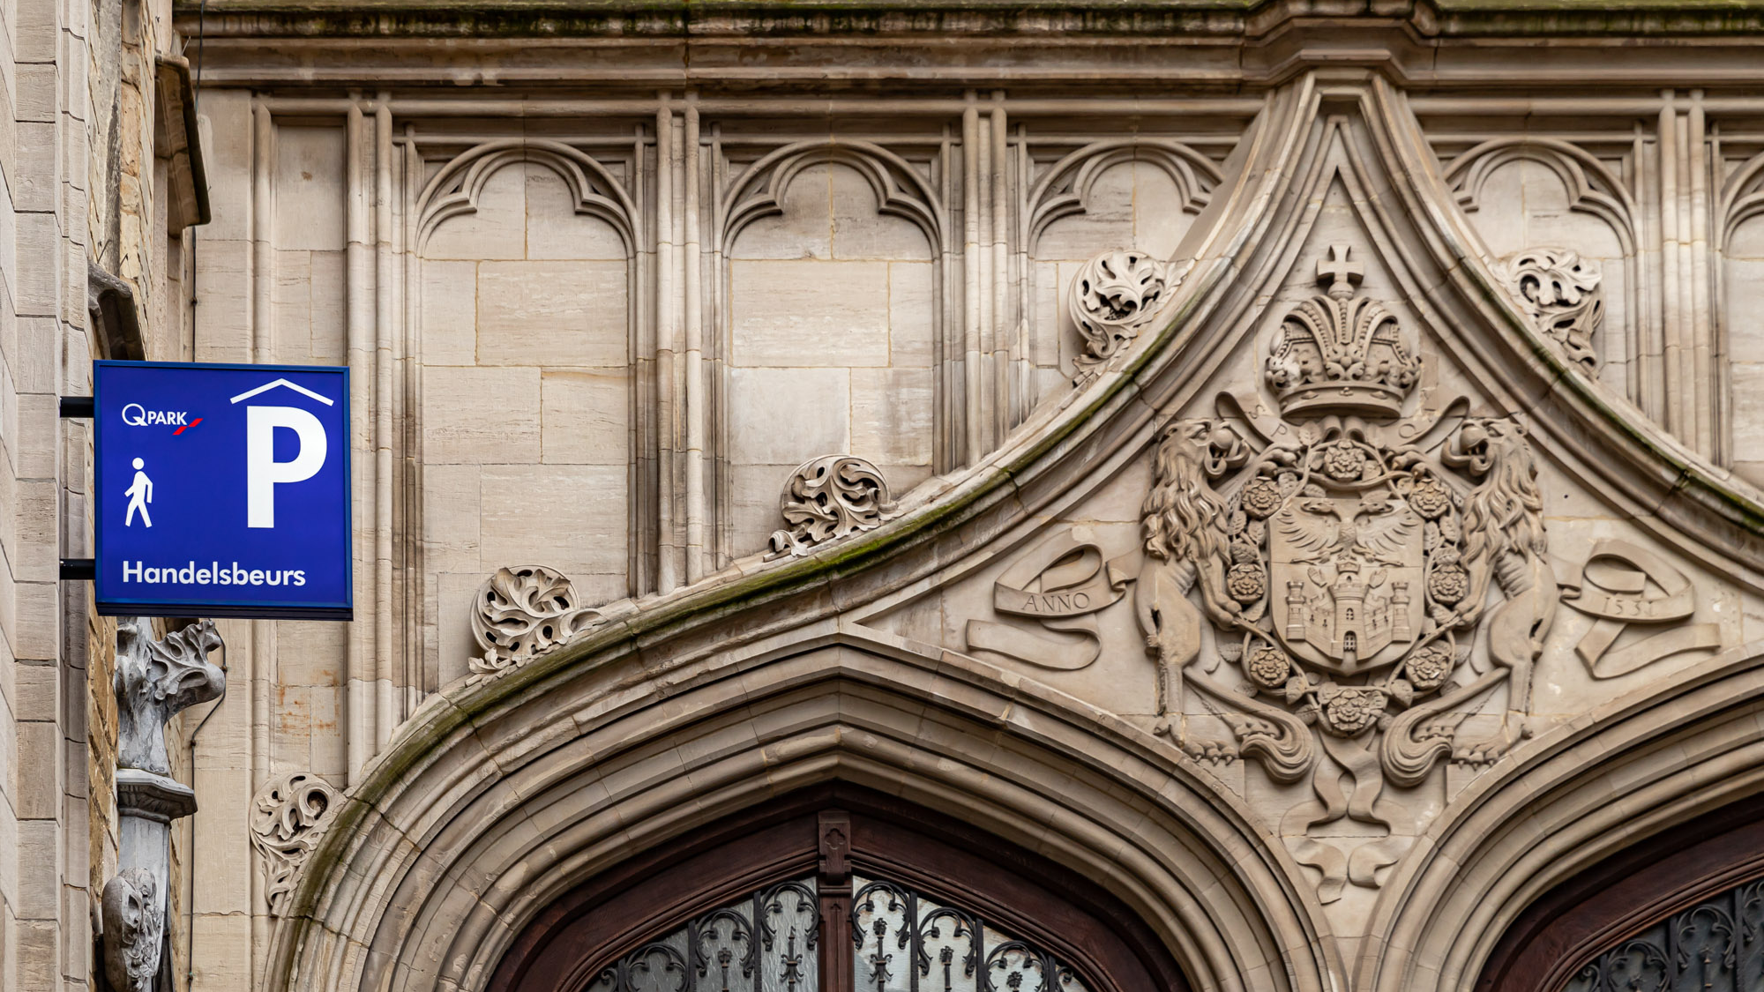
Brand Identity Standards
Q-Park BV | Sacha Oerlemans | 2024

Slide 2
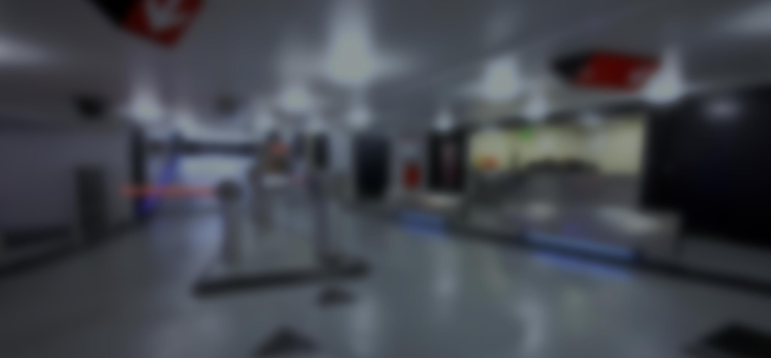

Menu
About
branding
Q-Park
brand & logo
Q-Park
banner
Q-Park
colour green
Q-Park
white column
Images
Language
Communication
PowerPoint
House-style

Slide 3

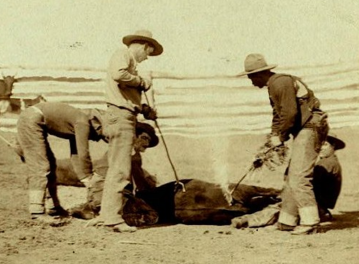

About branding
About branding
Q-Park brand & logo
Q-Park banner
Q-Park colour green
Q-Park white colomn
Images
Language
Communication
PowerPoint
House-style

Slide 4
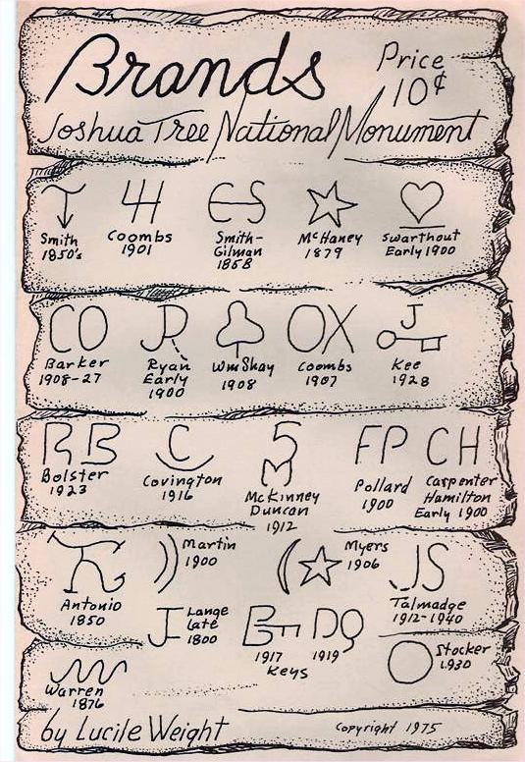
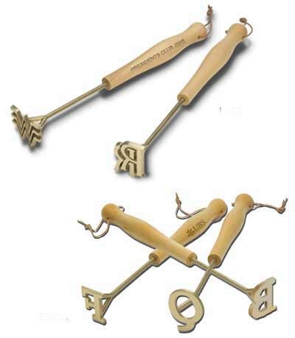
About branding
About branding
Q-Park brand & logo
Q-Park banner
Q-Park colour green
Q-Park white colomn
Images
Language
Communication
PowerPoint
House-style

Slide 5

























About branding
About branding
Q-Park brand & logo
Q-Park banner
Q-Park colour green
Q-Park white colomn
Images
Language
Communication
PowerPoint
House-style

Slide 6
About branding
          Companies with brands have high share value
          They hold strong positions in customers’ minds
About branding
1.230
Q-Park brand & logo
Q-Park banner
Q-Park colour green
Q-Park white colomn
Images
Language
GOODWILL
Communication
PowerPoint
House-style

Slide 7
About branding
About branding
Q-Park brand & logo
Brand awareness + image + trust + reputation
Q-Park banner
Q-Park colour green
€
The best guarantee
of future earnings
The capacity
to generate cash flows
Q-Park white colomn
Images
Language
Communication
PowerPoint
House-style

Slide 8
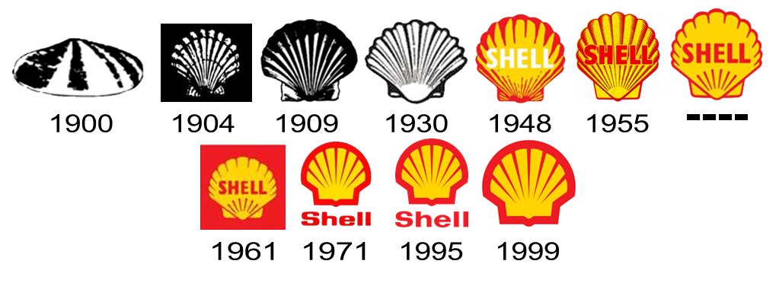
About branding

Slide 9
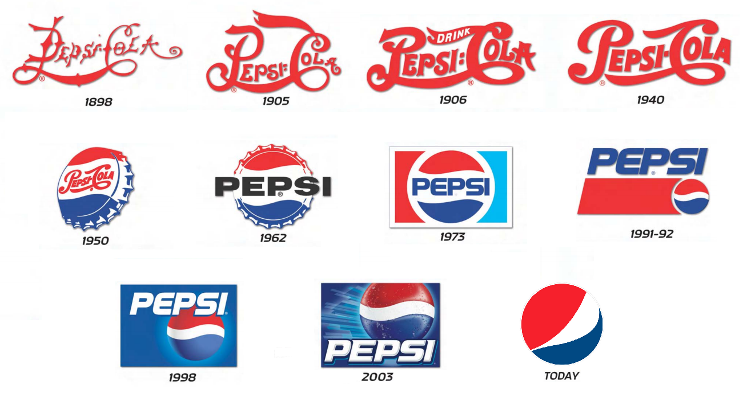
About branding

Slide 10
Q-Park brand
About branding
Service
Q-Park brand & logo
Strong
market
Position
Reliability
Well lit
  Development
Q-Park banner
Promise
Quality focus
Mission
  Off-street
  parking
Ethics
Q-Park colour green
Clean
Design
Vision
Customer satisfaction
Q-Park white colomn
Q-PARK
Quality in parking
Images
Strategic locations
Safety
Operational excellence
Language
Renovation
Policy
Sustainable mobility
Core values
Communication
Quintessence
Innovative
PowerPoint
House-style

Slide 11


Q-Park brand
The Q-Park name dates from 1995
The Q-Park logo dates from 1996
The Q-Park brand elements date from 2004
The Q-Park logo is styled with ‘parking spaces’
About branding
Q-Park brand & logo
Q-Park banner
Q-Park colour green
Q-Park white colomn
Images
Language
Communication
PowerPoint
House-style

Slide 12

Q-Park logo & colour
        Q-Park red
PMS 485
CMYK C0, M100, Y91, K0
RGB R217, G03, B39
RAL 3020
3M 3630-043
HEX #D90327
Black 60%
Shades of red only in tables and charts
Never use black on red (except clothing)
Never use red as background (except clothing)
About branding
Q-Park brand & logo
Black
Q-Park red
PMS, CMYK,
RAL or RGB
Q-Park banner
Q-Park colour green
Q-Park white colomn
Images
Language
Black
60% black
Communication
PowerPoint
House-style

Slide 13

Q-Park logo & space
File Edit Image Layer Type Select Filter 3D View Window Help
About branding
Feather: Opacity: Style:
0 px
100%
Normal
Q-Park brand & logo
Q-Park banner
Q-Park colour green
Q-Park white colomn
Images
Aa
Language
Communication
PowerPoint
House-style

Slide 14

Q-Park logo & space
File Edit Image Layer Type Select Filter 3D View Window Help
About branding
Feather: Opacity: Style:
0 px
100%
Normal
Q-Park brand & logo
Q-Park banner
Q-Park colour green
Q-Park white colomn
Images
Aa
Language
Communication
PowerPoint
House-style

Slide 15
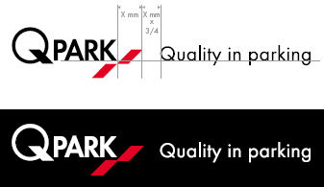
Q-Park logo & tag line
File Edit Image Layer Type Select Filter 3D View Window Help
Tag line next to logo
Never translated
About branding
Feather: Opacity: Style:
0 px
100%
Normal
Q-Park brand & logo
Q-Park banner
Q-Park colour green
Q-Park white colomn
Images
Aa
Language
Communication
PowerPoint
House-style

Slide 16
















Q-Park logo don’ts
About branding
Q-Park brand & logo
Q-Park banner
Q-Park colour green
Q-Park white colomn
Images
Language
Communication
PowerPoint
House-style

Slide 17





Q-Park logo don’ts
About branding
Q-Park brand & logo
Q-Park banner
Q-Park colour green
Q-Park white colomn
Images
Language
Communication
PowerPoint
House-style

Slide 18








Q-Park logo don’ts
Don’t omit the styled Q in a name
Don’t combine the logo with a name
Don’t bastardise the logo
About branding
Q-Park brand & logo
Q-Park banner
Q-Park colour green
Q-Park white colomn
Images
Language
Communication
PowerPoint
House-style

Slide 19
Q-Park logo & parking facility name
File Edit Image Layer Type Select Filter 3D View Window Help
Logo in front of name only in and around parking facilities
About branding
Feather: Opacity: Style:
0 px
100%
Normal
Q-Park brand & logo
Q-Park banner
Q-Park colour green
Q-Park white colomn
Images
Aa
Typeface Futura T Medium
Capital letters
Spacing 30*
Car park name and ‘Park’ in logo
are of the same height
Language
Communication
PowerPoint
House-style

Slide 20
Q-Park typeface
Basic typeface is FuturaT (digital alternative is Arial)
Install FuturaT
Fonts Q-Park / Start / Configuration screen /
Typefaces / File / Install new typeface
About branding
AaBb
AaBb
Q-Park brand & logo
Q-Park banner
Q-Park colour green
Q-Park white colomn
Typeface for body copy is FuturaT 11pts (Arial 10pts)
For emphasis, use FuturaTDem or underline (not bold)
Use 1.5 line spacing
Use 0.7 red line thickness
A
AaBb
AaBb
AaBb
1.5
Images
A
Language
Communication
PowerPoint
House-style
In correspondence

Slide 21




Q-Park colour green
        In parking facilities, for pedestrian guidance
PMS 376C
CMYK C50, M0, Y100, K0
RGB R135, G215, B0
RAL 6018
Oracal 8500-63 (lime tree green)
HEX #87d700
About branding
Q-Park brand & logo
Q-Park banner
Q-Park colour green
Q-Park white colomn
Images
Language
Communication
PowerPoint
House-style

Slide 22
Q-Park white column
White column below black box is empty
About branding
Q-Park brand & logo
Q-Park banner
Q-Park colour green
Q-Park white colomn
Images
Language
Communication
PowerPoint
House-style

Slide 23
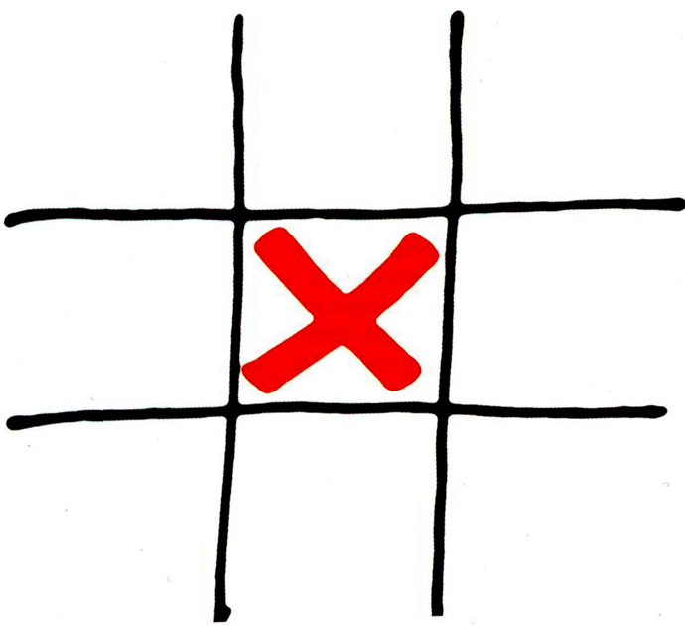
Q-Park white column
White column below black box is empty
  No visuals
About branding
Q-Park brand & logo
Q-Park banner
Q-Park colour green
Q-Park white colomn
Images
Language
Communication
PowerPoint
House-style

Slide 24
Q-Park white column
White column below black box is empty
  No visuals
  No copy
About branding
Q-Park brand & logo
No copy
in white left column
Q-Park banner
Q-Park colour green
Why?
Q-Park white colomn
Images
Language
Communication
PowerPoint
House-style

Slide 25

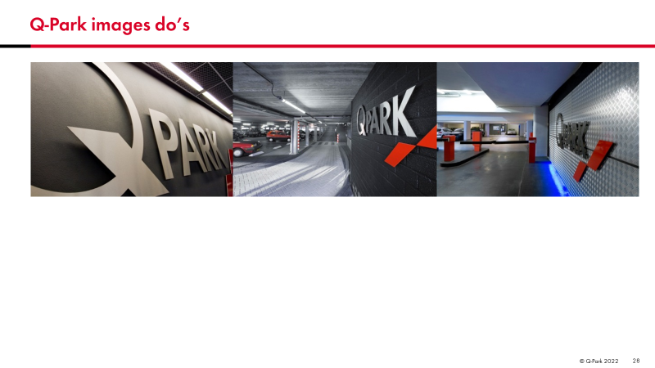
Q-Park images do’s
Start Insert Design Transitions Animations Slideshow Check View
Place images flush against each other,
About branding
Q-Park brand & logo
Q-Park banner
Q-Park colour green
Q-Park white colomn
Images
Language
Communication
PowerPoint
House-style

Slide 26
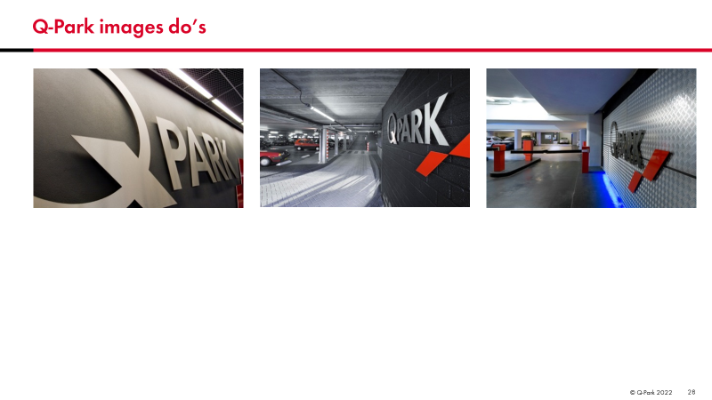
Q-Park images do’s
Start Insert Design Transitions Animations Slideshow Check View
Place images flush against each other,
… or with a space in between, yet always aligned
About branding
Q-Park brand & logo
Q-Park banner
Q-Park colour green
Q-Park white colomn
Images
Language
Communication
PowerPoint
House-style

Slide 27
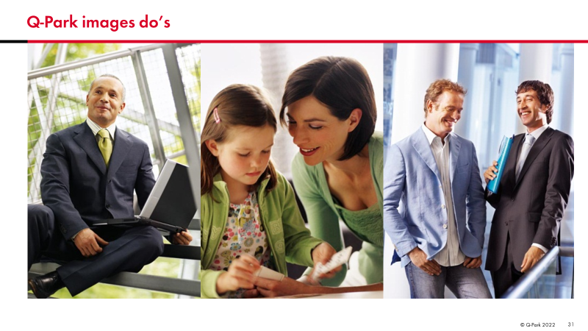
Q-Park images do’s
Start Insert Design Transitions Animations Slideshow Check View
Images may be placed flush against red bar,
… yet never overlap red bar
About branding
Q-Park brand & logo
Q-Park banner
Q-Park colour green
Q-Park white colomn
Images
Language
Communication
PowerPoint
House-style

Slide 28
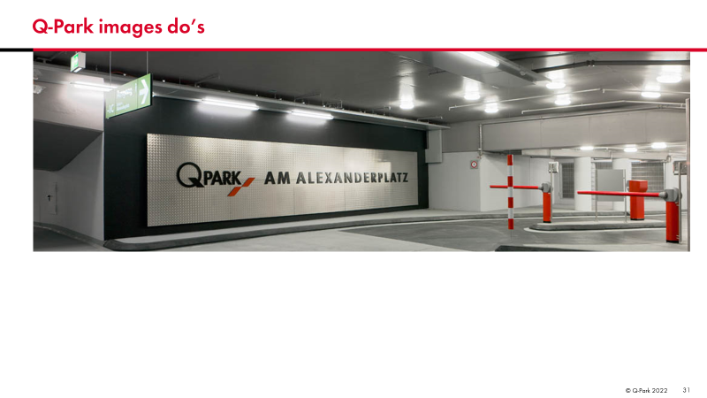
Q-Park images do’s
Start Insert Design Transitions Animations Slideshow Check View
Images may be placed flush against red bar,
… yet never overlap red bar
About branding
Q-Park brand & logo
Q-Park banner
Q-Park colour green
Q-Park white colomn
Images
Language
Communication
PowerPoint
House-style

Slide 29
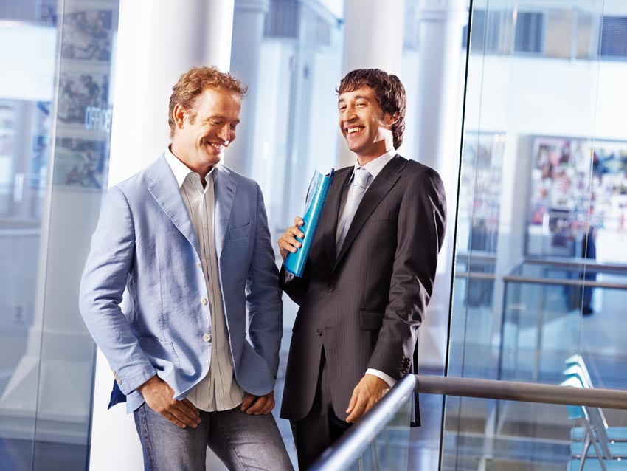
Q-Park images do’s
Detached images allowed everywhere in this type area
About branding
Q-Park brand & logo
Q-Park banner
Q-Park colour green
Q-Park white colomn
Images
Language
Communication
PowerPoint
House-style

Slide 30
Q-Park images don’ts
Detached images allowed everywhere in this type area
  Do NOT skew images
About branding
Q-Park brand & logo
Q-Park banner
Q-Park colour green
Q-Park white colomn
Images
Language
Communication
PowerPoint
House-style

Slide 31



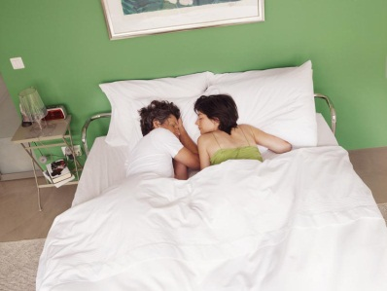
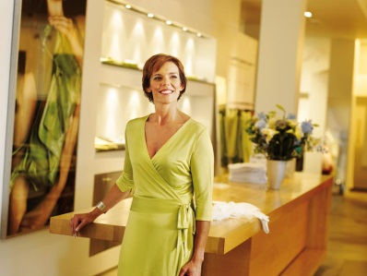

Q-Park images don’ts
Detached images allowed everywhere in this type area
  Do NOT skew images
  Do NOT use image collages
About branding
Q-Park brand & logo
Q-Park banner
Q-Park colour green
Q-Park white colomn
Images
Language
Communication
PowerPoint
House-style

Slide 32

Q-Park images don’ts
File Edit Image Layer Type Select Filter 3D View Window Help
No frames around images
About branding
Feather: Opacity: Style:
0 px
100%
Normal
Q-Park brand & logo
Q-Park banner
Q-Park colour green
Q-Park white colomn
Images
Aa
Language
Communication
PowerPoint
House-style

Slide 33
Q-Park language
Basic language is British English (not American, use spell check)
Organisation | NOT | Organization
Programme | NOT | Program
Colour | NOT | Color
See English style guide
About branding
Q-Park brand & logo
Q-Park banner
Q-Park colour green
Q-Park white colomn
Images
Language
Communication
PowerPoint
House-style
Notes:
Nummerplaat (QNL = Kenteken)
U vorm (QNL = je vorm)

Slide 34
Q-Park language
About branding
Q-Park | NOT | Q-park, q-park, q-Park
Quality in parking | NOT | quality in parking, Quality in Parking
Parking spaces | NOT | places, spots (dogs have spots, we clean spots)
Parking facilities | NOT | car parks, garages
Season ticket | NOT | subscriptions
Million | NOT | mio
See Q-Park terminology excel file
Q-Park brand & logo
Q-Park banner
Q-Park colour green
Q-Park white colomn
Images
Language
Communication
PowerPoint
House-style

Slide 35

Q-Park language
About branding
Always
proofread
and edit
KISS and
SMART
principle
Q-Park brand & logo
Q-Park banner
Q-Park colour green
Q-Park white colomn
Is your text structured
and logical?
Accurate
Concise
Consistent
Images
Language
Communication
PowerPoint
House-style

Slide 36







Q-Park country order
Country order based on financial preference
Country name | Flag | ISO Code | Currency
Netherlands |  | NL | EUR
Germany |  | DE | EUR
France |  | FR | EUR
Belgium |  | BE | EUR
UK |  | UK | GBP
Ireland |  | IE | EUR
Denmark |  | DK | DKK
About branding
Q-Park brand & logo
Q-Park banner
Q-Park colour green
Q-Park white colomn
Images
Language
Communication
PowerPoint
House-style

Slide 37

Q-Park templates
About branding
Start Word, PowerPoint or Excel, go to …
Q-Park brand & logo
File / Options / Save / Default personal templates location
Q-Park banner
Insert: \\qpark325.q-park.com\IDEFIX\Templates\Office
Q-Park colour green
Q-Park white colomn
In Word, PowerPoint or Excel, select New, go to tab Personal to find Q-Park template(s)
Images
To incorporate visuals and/or pictures, consult IDEFIX
Language
Communication
PowerPoint
House-style

Slide 38

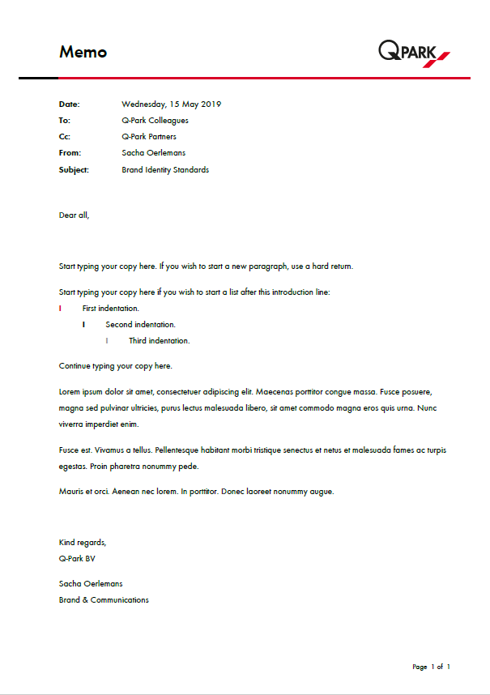
Q-Park word
        Word uses dynamic templates
Memo
Meeting Agenda / Minutes
Press Release
Internal Notification
        Options for FuturaT
Embed typeface in file
Attach file as PDF
Use Arial (as last resort)
About branding
Q-Park brand & logo
Q-Park banner
Q-Park colour green
Q-Park white colomn
Images
Language
Communication
PowerPoint
House-style

Slide 39

Q-Park e-mail
About branding
Q-Park brand & logo
Kind regards,
Q-Park NL
Peter Woods
Regional Manager
T +31 433 297 717
F +31 433 251 530
M +31 655 222 333
E peter.woods@q-park.com
I www.q-park.com
Q-Park banner
Q-Park colour green
Q-Park white colomn
Images
Language
Communication
PowerPoint
House-style

Slide 40

Q-Park PowerPoint presentation
About branding
Q-Park brand & logo
In PowerPoint:
Q-Park banner
Typeface for header is FuturaTDem 28pts
Q-Park colour green
Typeface for body copy is FuturaT 18pts
Data in graphs is minimum 14pts
Q-Park white colomn
Images
In handouts:
Language
Typeface for header/footer is FuturaT 9pts
Communication
PowerPoint
House-style

Slide 41
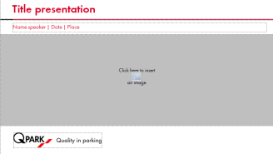

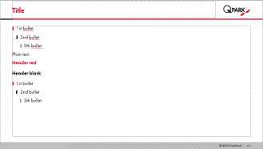
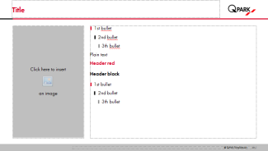
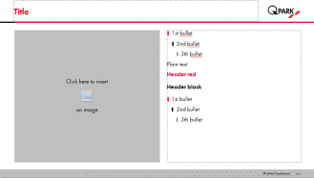
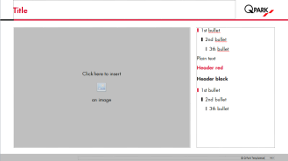
Use single line headings only
Start Insert Design Transitions Animations Slideshow Check View
About branding
Q-Park brand & logo
Q-Park banner
Q-Park colour green
Q-Park white colomn
Images
Language
Communication
PowerPoint
House-style

Slide 42

Use standard layout options
About branding
Q-Park brand & logo
Q-Park banner
Q-Park colour green
Q-Park white colomn
Images
Language
Right mouse click
Layout
Make your selection
Use object options within PowerPoint
Communication
PowerPoint
House-style

Slide 43

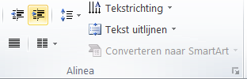
Usage of bullet lists
TEXT LEVELS
        List your items by means of bullets
Be consistent in usage of capitals and/or punctuation
Do not indent more than 2 steps
  First indent
    Second indent
About branding
Level up
Q-Park brand & logo
Q-Park banner
Level down
Q-Park colour green
Q-Park white colomn
1
  1st bullet (18 pt.)
Images
2
    2nd bullet (18 pt.)
3
Language
    3th bullet (18 pt.)
4
Communication
      Plain text (18 pt.)
5
      Header red (18 pt.)
PowerPoint
6
      Header black (18 pt.)
House-style

Slide 44




Usage of tables, graphs, charts and art
          Tables, graphs, charts and art must fit within given areas
About branding
Q-Park brand & logo
Q-Park banner
Q-Park colour green
Q-Park white colomn
Images
Language
Communication
PowerPoint
House-style

Slide 45
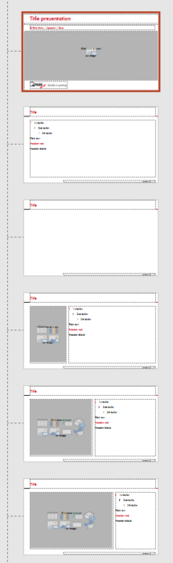

Usage of art – full bleed exception
Start Insert Design Transitions Animations Slideshow Check View
About branding
Q-Park brand & logo
Q-Park banner
Q-Park colour green
Q-Park white colomn
Images
Language
Communication
PowerPoint
House-style

Slide 46
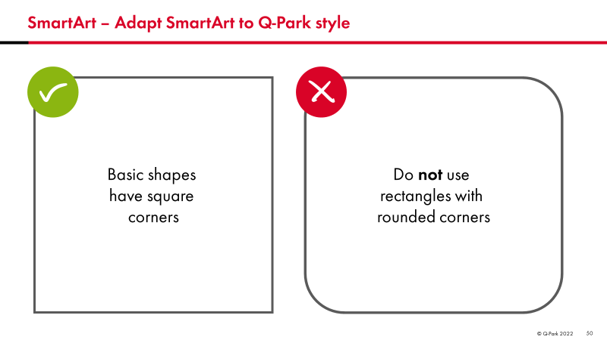
Model: SmartArt – Adapt SmartArt to Q-Park style
Start Insert Design Transitions Animations Slideshow Check View
About branding
Q-Park brand & logo
Q-Park banner
Q-Park colour green
Q-Park white colomn
Images
Language
Communication
PowerPoint
House-style

Slide 47
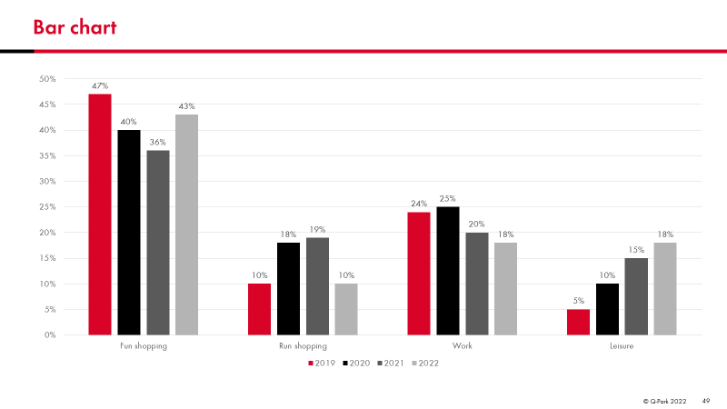
Model: Bar chart
Start Insert Design Transitions Animations Slideshow Check View
About branding
Q-Park brand & logo
Q-Park banner
Q-Park colour green
Q-Park white colomn
Images
Language
Communication
PowerPoint
House-style

Slide 48
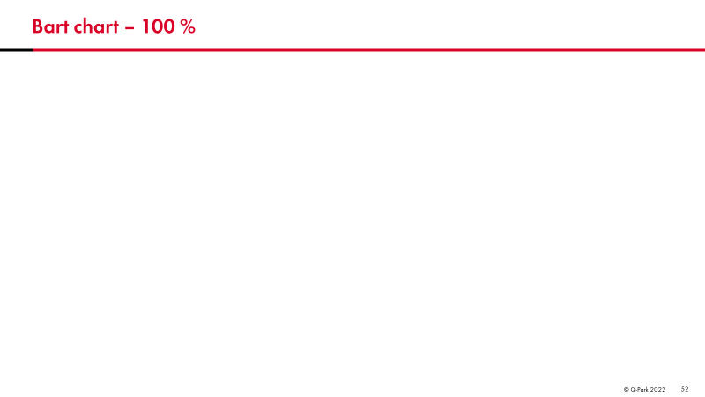
Model: Bar chart 100%
Start Insert Design Transitions Animations Slideshow Check View
About branding
Q-Park brand & logo
Q-Park banner
Q-Park colour green
Q-Park white colomn
Images
Language
Communication
PowerPoint
House-style

Slide 49
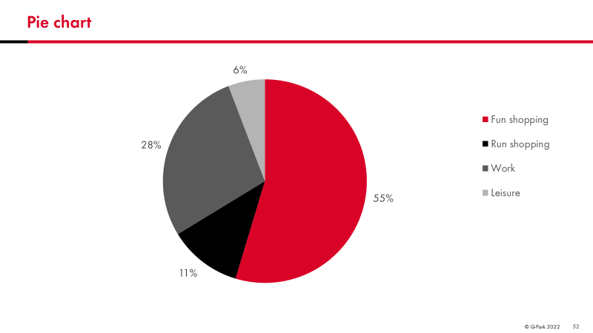
Model: Pie chart
Start Insert Design Transitions Animations Slideshow Check View
About branding
Q-Park brand & logo
Q-Park banner
Q-Park colour green
Q-Park white colomn
Images
Language
Communication
PowerPoint
House-style

Slide 50
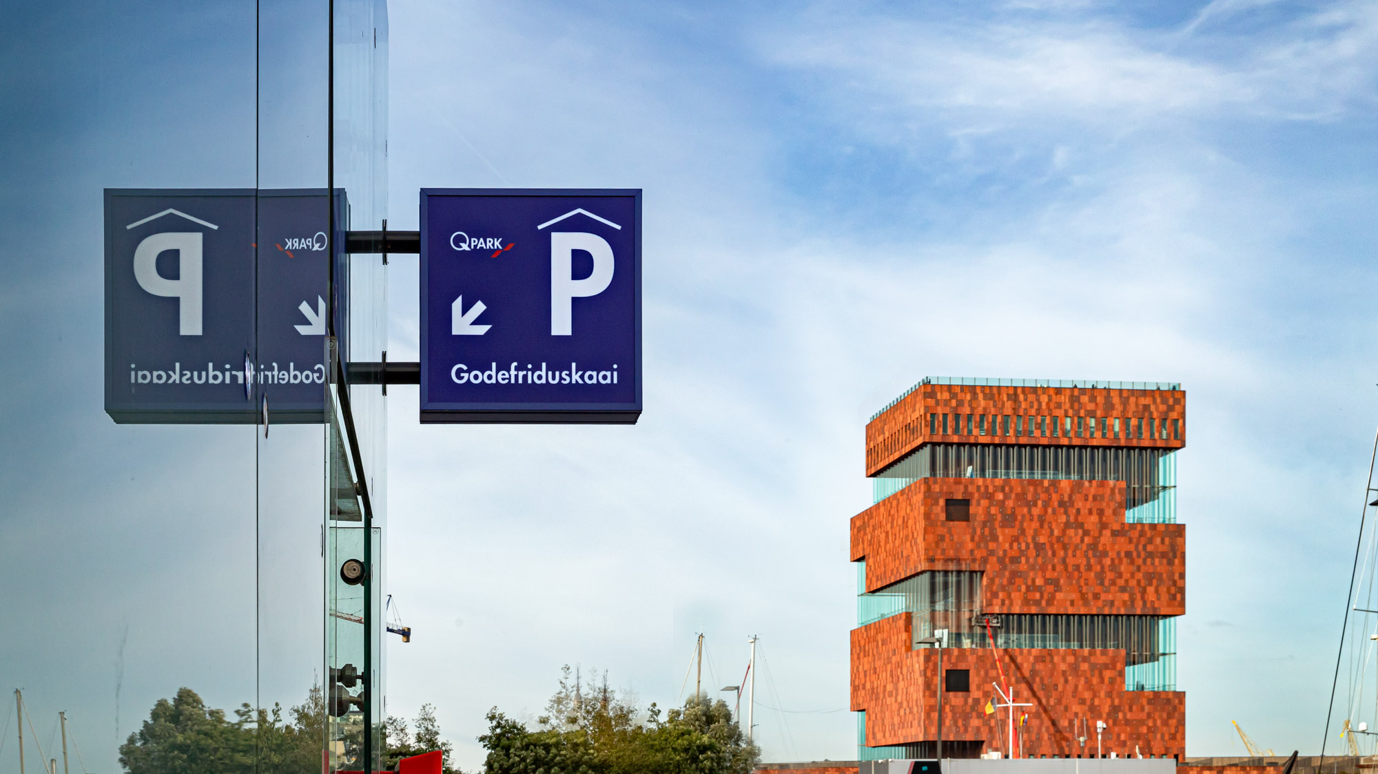
Q-Park House Style
Q-Park BV | Sacha Oerlemans | 2024

Slide 51
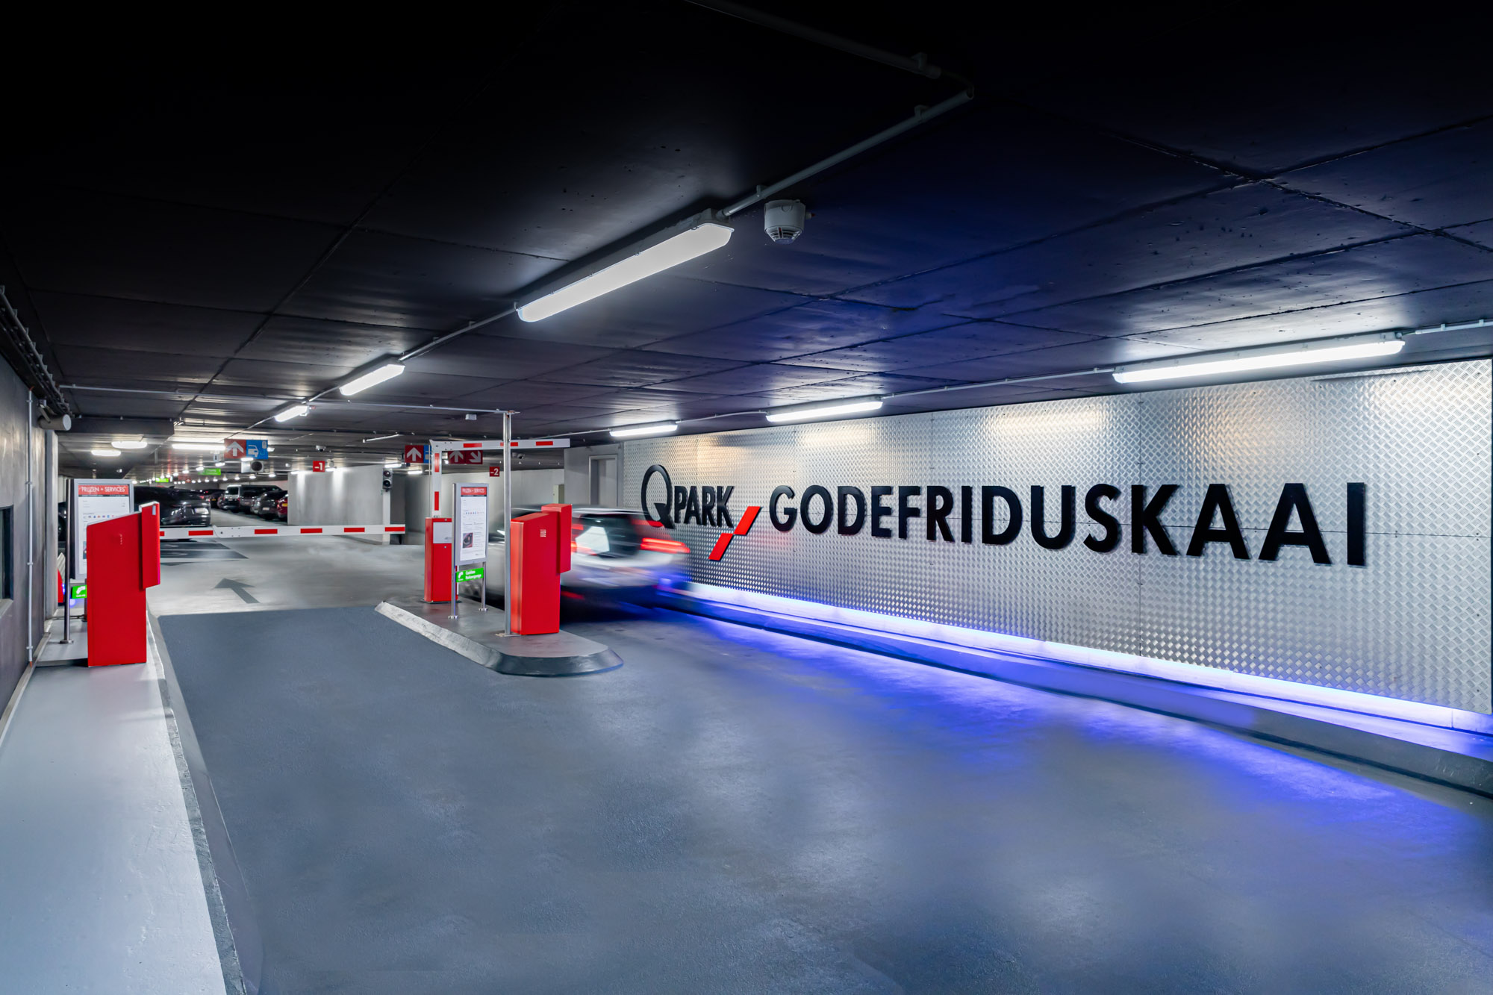

Slide 52
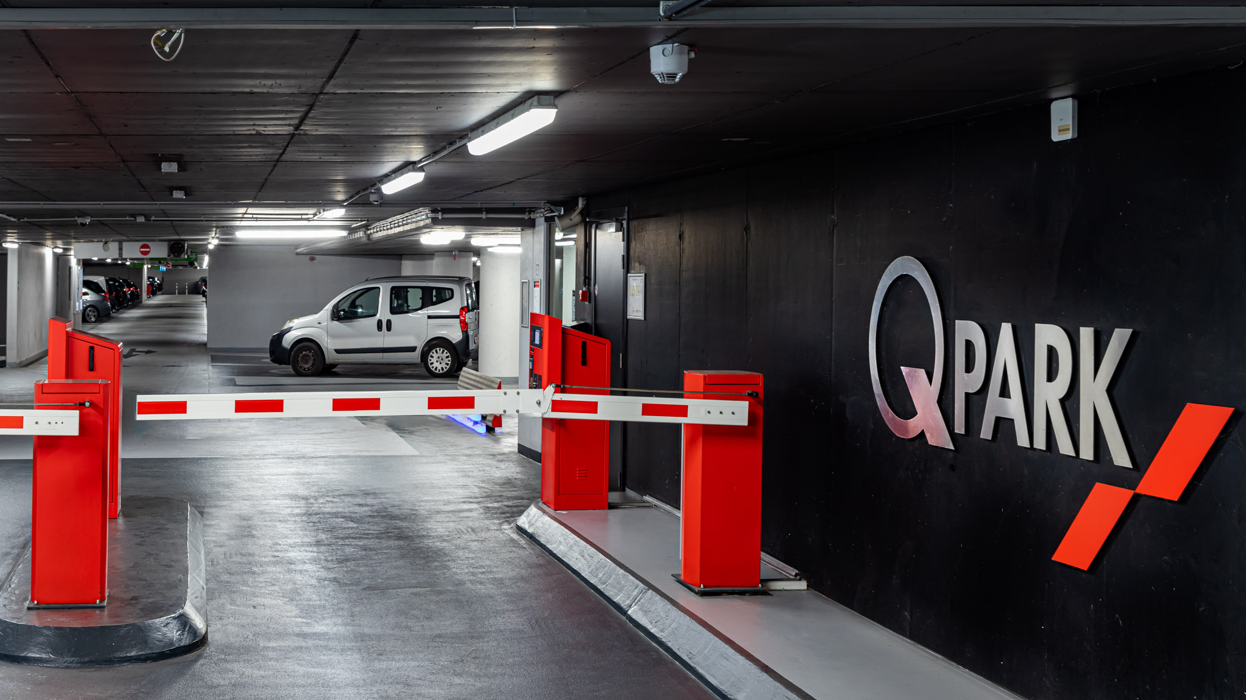

Slide 53
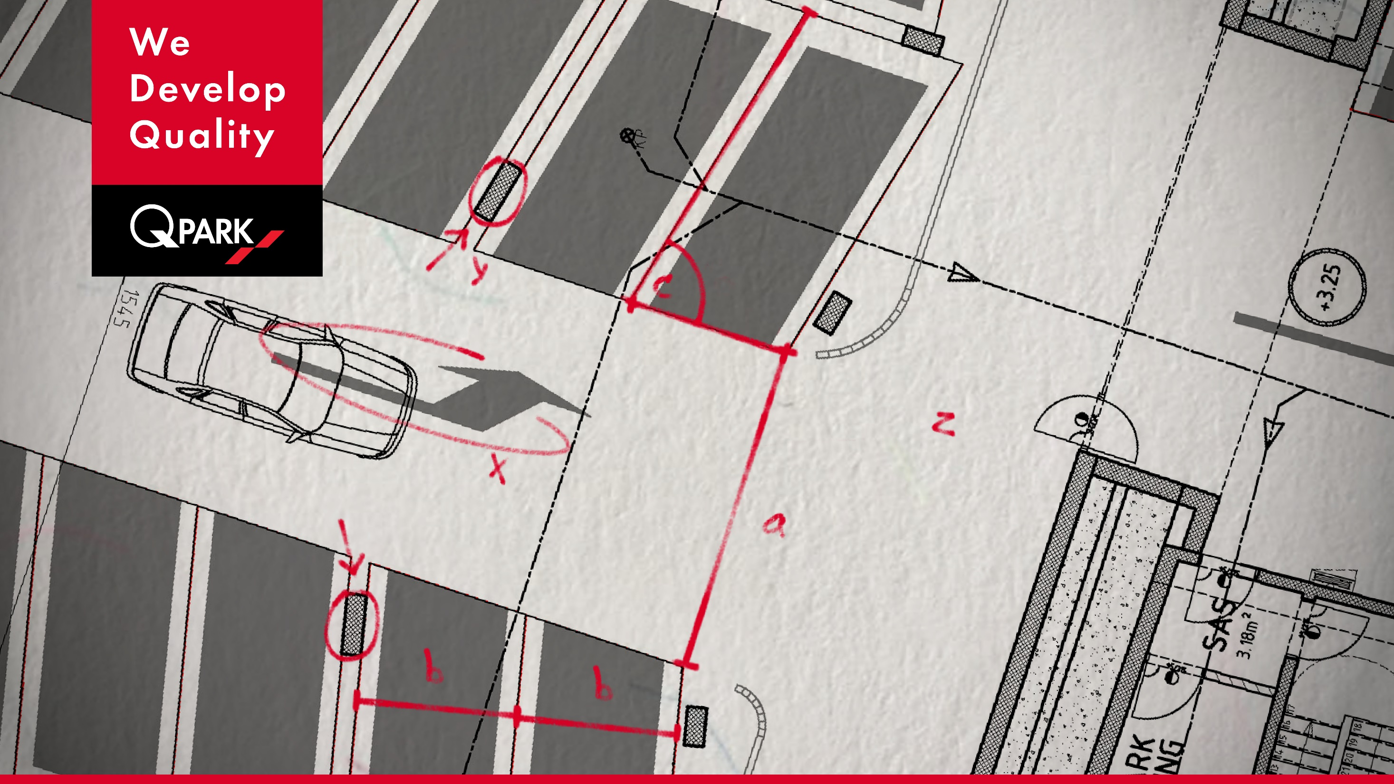

Slide 55

Q-Park Charts & Graphs Colour Exercise
Q-Park BV | Sacha Oerlemans | 2024
Notes:
Consider first impression colours vs second impression colours

Slide 56
Standard colour scheme – based on 4 data points
RGB R G B
Red: 217 3 39
Black: 0 0 0
Dark grey: 90 90 90
Mid grey: 180 180 180

Slide 57
Standard colour scheme – based on 5 data points
RGB R G B
Red: 217 3 39
Black: 0 0 0
Dark grey: 90 90 90
Mid grey: 180 180 180
Light grey: 240 240 240

Slide 58
Standard colour scheme – based on 6 data points
RGB R G B
Red: 217 3 39
Black: 0 0 0
Dark grey: 90 90 90
Mid grey: 180 180 180
Light grey: 240 240 240
White: 255 255 255
NOTE:
Max 5 data points in Q-Park colour scheme
I.e. the 6th data point is white
Advise is to customise when exceeding 5 data points, see next slides for tips and suggestions

Slide 59
Customised colour/shape scheme – based on 7 data points
Play with colour black, red and grey
Play with line weights and dashes
Additional grey tones:
Mid-dark grey: RGB 135 135 135
Mid-light grey: RGB 215 215 215

Slide 60
Customised colour/shape scheme – based on >7 data points
Play with colour black, red, grey and green
Play with line weights and dashes

Slide 61
Customised colour/shape scheme – based on >10 data points
Play with colour black, red, grey, green and light blue
Play with line weights and dashes

Slide 62
All colours used – in RGB
Colours | R | G | B
Standard
Red | 217 | 3 | 39
Black | 0 | 0 | 0
Dark grey | 90 | 90 | 90
Mid grey | 180 | 180 | 180
Light grey | 240 | 240 | 240
White | 255 | 255 | 255
Customised
Mid-dark grey | 135 | 135 | 135
Mid-light grey | 215 | 215 | 215
Green (new) | 135 | 215 | 0
Blue (P) | 0 | 56 | 123
Light blue (EV) | 0 | 175 | 250
Q-Park PowerPoint has a default Colour Theme
If you need more colours:
  Select … More colours*
  Select … Custom tab
  Select … Colour model RGB**
  Fill out R, G and B numbers of desired colour
*In Font colour, Shape Fill or Shape Outline
** RGB is a colour scheme for your monitor, the three colours Red, Green and Blue produce over 16 million hues of light (if you need other colour schemes such as CMYK, PMS, RAL, HEX of 3M – check out the Q-Park Brand Identity Manual).

